Slide 1
Autonomous R/C Car
University “Politehnica” of Bucharest
Faculty of Electronics, Telecommunications and Information Technology
Thesis advisor: Student:
Conf. Dr. Ing. Dumitru Nastac Mihnea Manea

Slide 2
Introduction
Passion for cars
Very important field in automotive
New cars come with these systems
Soon will be mandatory safety systems
The field is relatively new and will continue to develop in the next years

Slide 3
Thesis’ Main Chapters
Implemented Functions
Technologies Used in Project
Hardware
Slave Device Software
Master Device Software
Testing and Problems

Slide 4
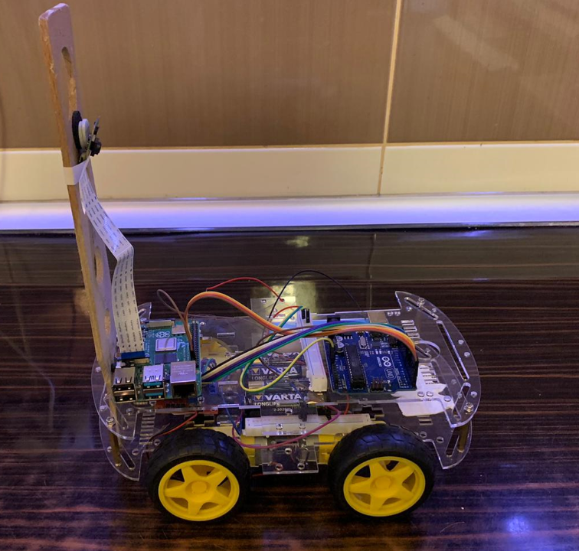
Implemented Functions
Moving Functions
Lane Keep
Stop Sign Detection
Obstacle Detection

Slide 5
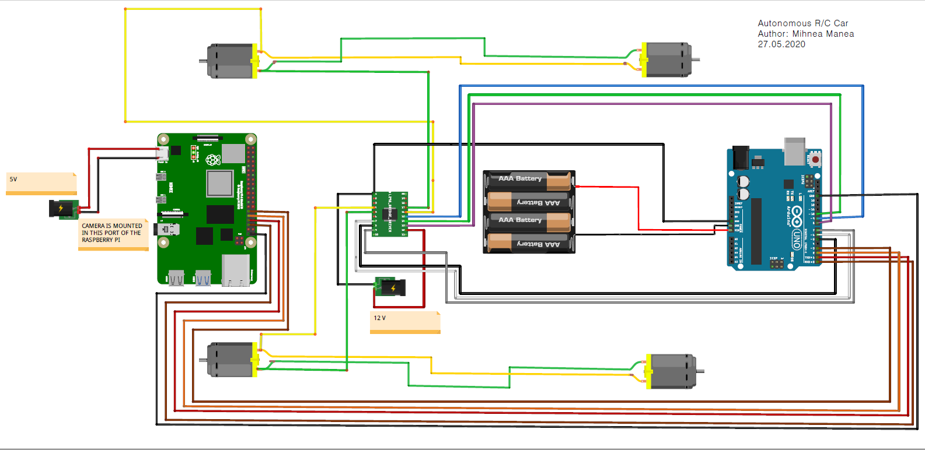
Hardware Block Diagram

Slide 6
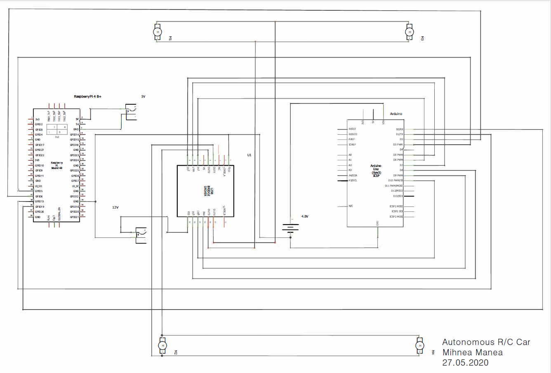
Hardware Electrical Scheme

Slide 7
Software Diagram
Master Device
Slave Device
Raspberry Pi Camera
Raspberry Pi
-Lane Detection
-Obstacle and Sign Detection
Commands
Arduino
-Moving Functions
L298N driver
Moving Function | Decimal Number
Forward | 0
Right2 | 2
Right3 | 3
Left2 | 5
Left3 | 6
Stop | 7

Slide 8
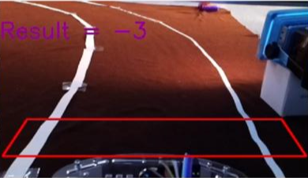
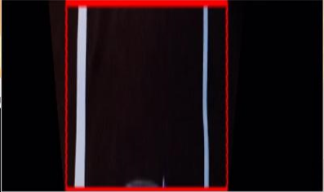

Lane Detection
Roi (Region of Interest)
Perspective Transform
Threshold Operations
Binarization
Canny Edge Detection
Lane Finding
Lane Centering
Bird-Eye-View Perspective
RoI
Binarization

Slide 9

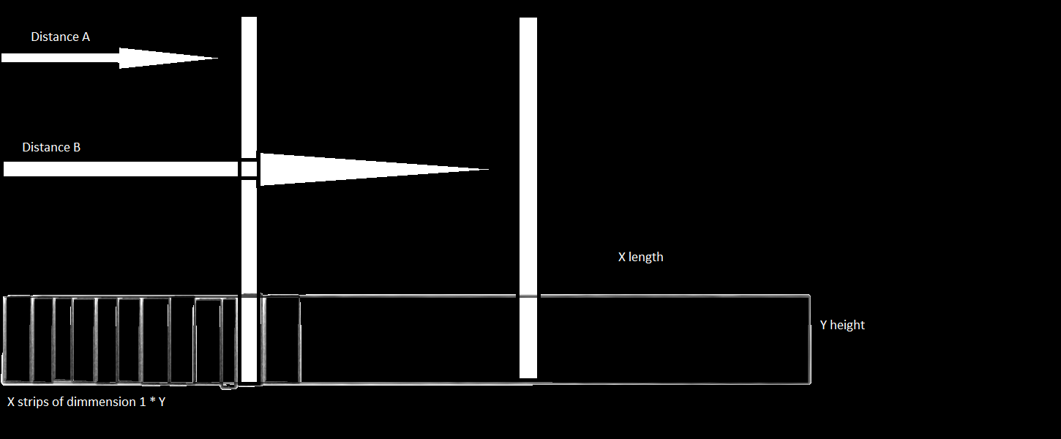
Lane Detection
Roi (Region of Interest)
Perspective Transform
Threshold Operations
Binarization
Canny Edge Detection
Lane Finding
Lane Centering
Canny Edge Detection
Lane Finding

Slide 10
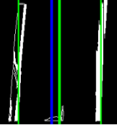
Lane Detection
Roi (Region of Interest)
Perspective Transform
Threshold Operations
Binarization
Canny Edge Detection
Lane Finding
Lane Centering

Slide 11
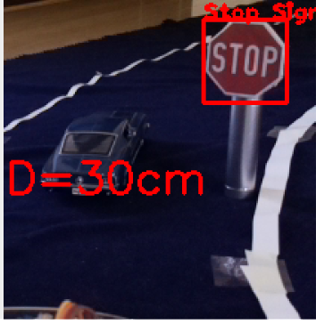
Stop Sign Detection
Cascade Classifier
DetectMultiScale()
Distance Computing
Sign detected?
No
Yes
20< Dist>5 ?
No
Yes
Lane Keep
Stop

Slide 12
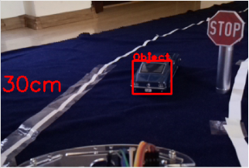
Obstacle detection
Cascade Classifier
DetectMultiScale()
Distance Computing
Obstacledetected?
No
Yes
20< Dist ?
No
Yes
Lane Keep
Stop

Slide 13
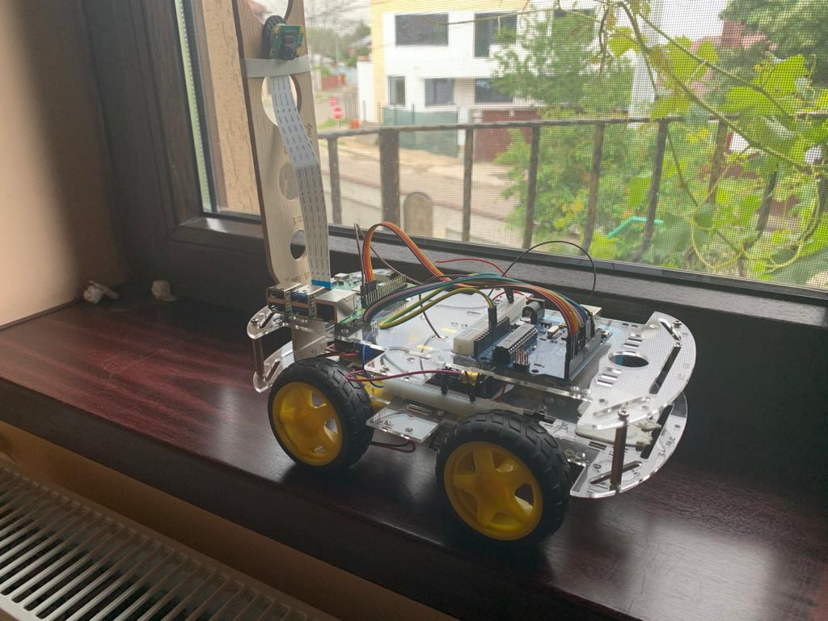
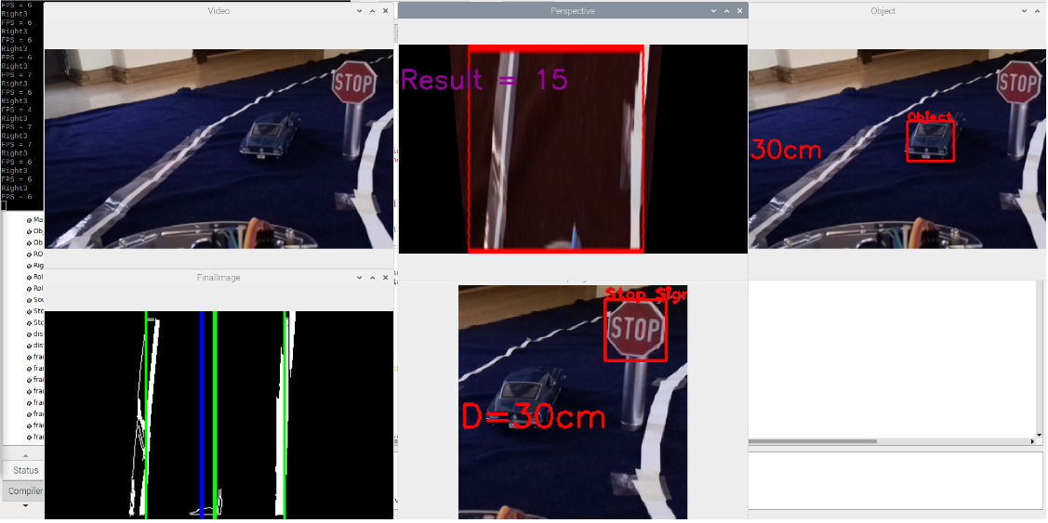
Results
All functions working at the same time
The Demo Car

Slide 14
Personal Contributions
RoI parameters
Moving functions fine tuning
Dataset for classifier
Threshold operations parameters
Linear equations computing for distance
Cascade Classifier parameters for better accuracy
80% accuracy for sign detection*
70% accuracy for obstacle detection*
*All tests were conducted in daylight or high intensity artificial light

Slide 15
Problems
Threshold Operations
Motors Speed
Library Problems
Supply Problems

Slide 16
Future Development
The slave device supports up to 16 commands from the master
Other ADAS functions can be implemented (adaptive cruise control using radar for example)
Sign detection can be upgraded by adding other signs into the dataset
Obstacle detection can be upgraded by adding more car models and shapes into the dataset
Communication with other cars can be implemented (Car Net) for safer driving
Ultrasonic sensors can improve the safety of obstacle detection

Slide 17
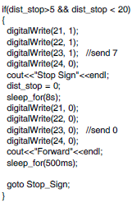
Conclusions
Successfully implemented ADAS functions into the toy car
Lane detection, obstacle and sign detection work very well in daylight conditions
Rewarding experience
Working with openCV and machine learning in an embedded project is very educative and useful at the same time.
Complicated problems may have simple solutions
Delay() function solved

Slide 18
Thank you !

